Slide 1

SailPoint has 2 products mainly : IdentityIQ (On-premise) and IdentityNow (Cloud SaaS)
IdentityNow shares the architecture of IdentityIQ, so let’s start IIQ Development which applies to IdentityNow as well.
What is IIQ ?
IIQ is a simple war file just like a J2EE project
IIQ follows OOPS (Object Oriented Programming Structure), so everything is an object which is represented in XML
If you learn about each individual object and how the objects are connected, there you are as a SailPoint Developer
What Skills do I need to become SailPoint Developer ?
Bean Shell Scripting (Same as Core Java)* - You need very basic java knowledge including OOPS, data types, if, for, while, date, exceptions, array list, hash map and file handling.
XML*
SQL (you don’t use much other than in Reports or interacting with DB directly)
PowerShell (to automate Microsoft stuff including AD/Azure AD/Exchange)
HTML for forms and email templates
Apache Velocity Script for customizing email notifications
CSS, Java script (very less used in customizing email notifications)
Notes:
IIQ stores all it’s objects in a database which is called identityiq
It has ~216 tables for every individual object
context is used to connect to database, which is available by default as an argument in entire SailPoint, you don’t need to write code to connect to DB explicitly.

Slide 2

#1. Identity Object
As SailPoint IIQ is identity management tool, let’s begin with identity object
How to read existing user data ?
Identity idObj = context.getObjectByName(Identity.class, “123456”);
Object type
Object name
Database connection
Method to get object by name
Table name to look into
User name
IIQ creates unique id for every object, so we can use that id as well to get identity object
Identity idObj = context.getObjectById(Identity.class, “0a0000057dae1f95817dae34a9d7001f”);
You can use these 2 methods goById or goByName (short form) for getting any object from IIQ DB by changing the object type and table name
This java code is almost same as
SELECT * from TABLE_NAME where user_name = ‘value’;
To log this data, you can use
System.out.println(idObj.toXml()); or log.error(idObj.toXml()); (log is recommended)
You can use return statement to print in the rule execution output

Slide 3

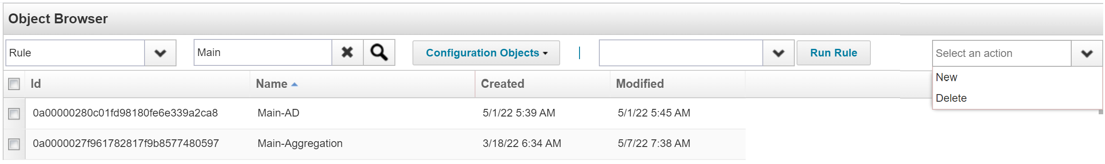
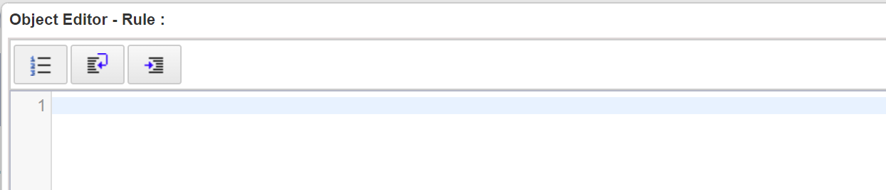
Creating Rule
Login to debug page http://localhost:8080/identityiq/debug
SailPoint IIQ has in built code editor, you don’t get any suggestions on syntax, no auto complete but it recognizes the key words.
You can use IDE as well, I have seen people using Eclipse.
You can execute The Rule, you can consider it as executing main method(thread) in Java.
Select object type as Rule
Select an action New, which will open blank Rule
Please note that SailPoint debug editor won’t generate any default code like boilerplate for HTML in VS code, you need to type everything
Alternative is to duplicate the existing Rule by: Open any existing Rule, change the name, remove id value and save it. This will create your rule, open it and update the code in source tag
You should write & as &amp; and < as &lt; when you are developing in debug editor. We will discuss about this in detail later.
Select the Rule from dropdown, click Run Rule

Slide 5

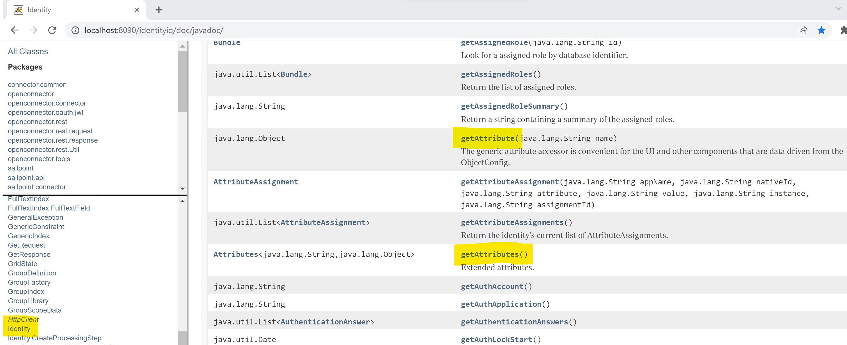
IIQ is about Reading the data also called Aggregation or Get
Writing the data also called Provisioning or Set
Well of course, same any IAM tool
IIQ Development is about
This getter and setter methods is called Beans in Java
Understanding IIQ API is same as: we do learn different classes in Java and their methods
For example, String class and its methods: contains, substring, equals, toLowercase…etc
Access IIQ API using http://localhost:8080/identityiq/doc/javadoc
Get the data using IIQ getter methods
Manipulate the data as per your requirements
Set the data using IIQ setter methods

Slide 6

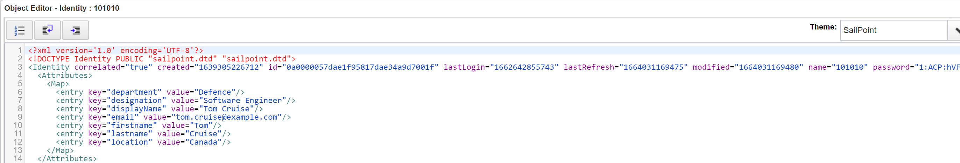
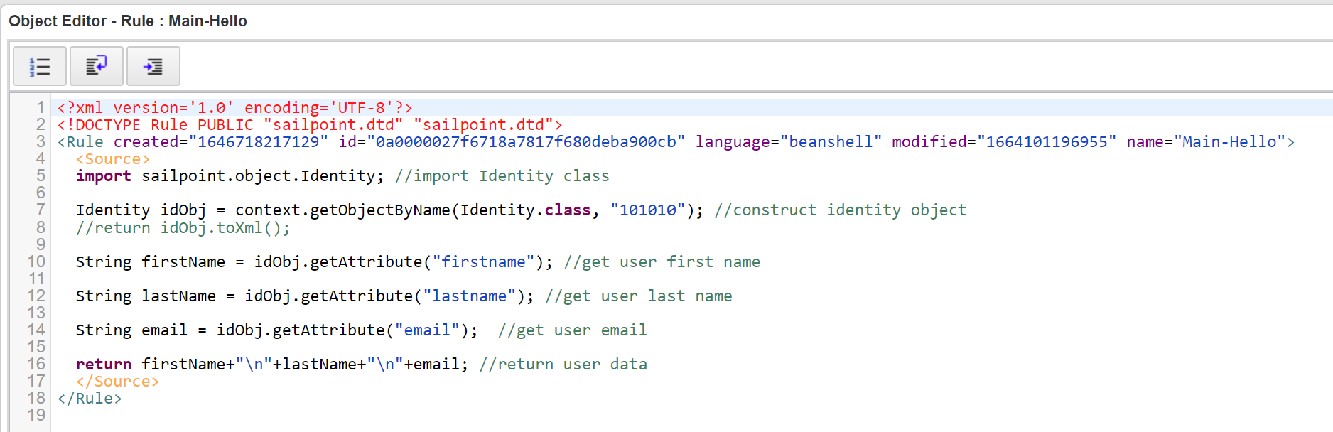
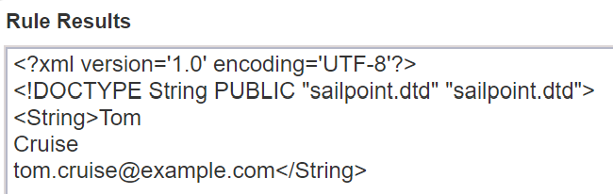
#Get the Data from Identity object
You can use getAttribute() method to extract any attribute by passing attribute name
As I mentioned earlier, IIQ represents objects in XML format as <Key, Value> pairs, for example

Slide 7

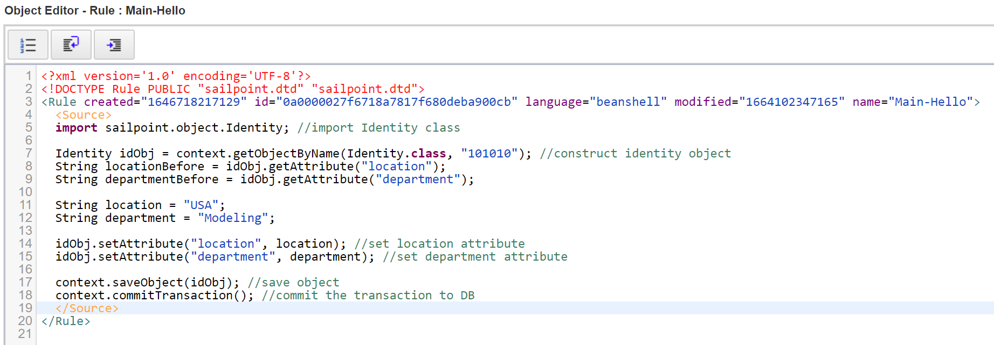
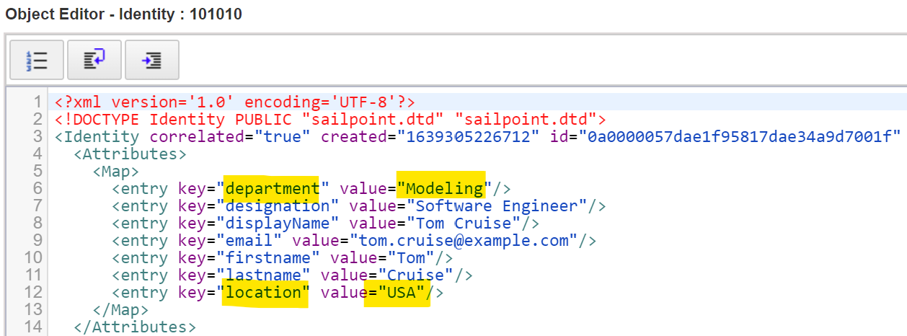
#Set the data to Identity Object
After executing the Rule, either checking the Identity object in Debug or in Identity Warehouse or now you know how to get attributes using code

Slide 8

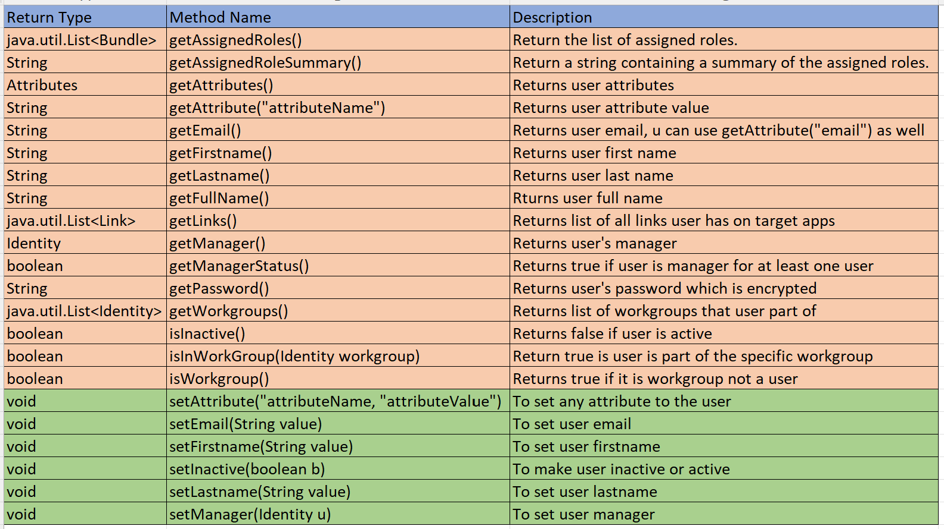
Identity object methods
Below are some of the commonly used methods on Identity
We haven’t discussed what is Bundle, Link, Workgroup objects. We will cover them in coming sessions.

